Slide 1
RUM

Slide 2
RUM
Produced by Sugarcane.
Sugarcane was introduced to Caribbean by Columbus and by 17th century it was being used to produce cheap spirit.
The Spanish explorers who followed Columbus brought with them the art of distilling.

Slide 3
RUM
It was chiefly the drink of Slaves.
Basically it was the juice of cane sugar mixed with water fermented and heated in a primitive still.
1st written reference of Rum comes from Barbados around 1600. It is believed that word Rum is derived from followings words:

Slide 4
RUM
  Rumbullion (rumpus)
  Rumbustion (uproar)
  Saccharum Officinarum
  Saccharum (Latin word for sugarcane)
Other names for Rum are:
  Kill-devil
  Barbados Water

Slide 5
RUM
In 17th &18th century with the end of the Spanish dominance in the Caribbean, and the growth of the British empire, rum spread abroad, first to the American colonies, and then to England.
Slaves from Africa were transported to Caribbean to work in sugarcane fields, molasses from here was sent to England for production of Rum and re-exported to Africa in exchange for more slaves.

Slide 6
RUM
By the mid seventeenth 17th Century sailors in British navy were receiving a ration of half pint of rum every day.
Rum was also called ‘Grogum’. In 1740 Admiral Vernon (Old Grog) ordered the ration to be watered down by adding four parts of water to one part of rum.

Slide 7
RUM
Rum is also called the ‘Nelson’s Blood’ after The battle of Trafalgar, as the Admiral’s body was preserved in a cask of rum for shipment back to England and burial.

Slide 8
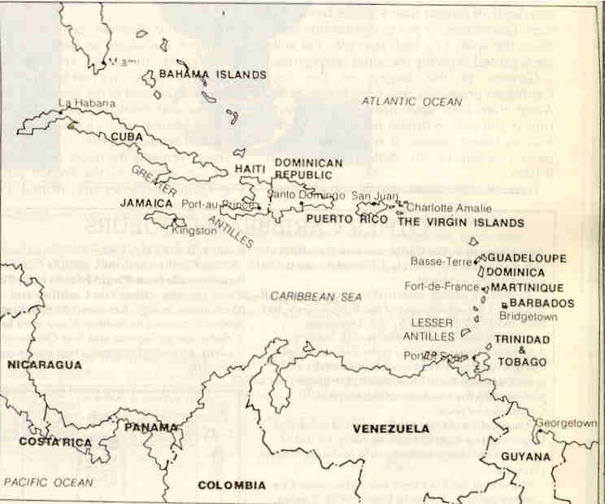

Slide 9
PRODUCTION
Rum is produced from sugar cane.
Freshly cut cane is cut and crushed among the rollers to extract the juice.
The residual pulp called the bagasse is crushed several times to extract all the juice.

Slide 10
PRODUCTION
Bagasse is often used in factories as a fuel in the boiler’s.
The extract is heated almost to the boiling point.
It is then cooled and the crystallized sugar is removed.

Slide 11
PRODUCTION
This results in rich, dark syrup free of impurities.
The syrup is centrifuged, by this process sugar crystals are removed for commercial sugar.
Leaves a very dark, treacly liquid called ‘Molasses’ or ‘Black strap’.

Slide 12
PRODUCTION
Rum is one of those few spirits which retains a lot of character of its base ingredient. Therefore each Rum varies with:
  variety of sugar cane
  mineral content
  sugar level
  climate
  soil

Slide 13
PRODUCTION
Quality of a good molasses is that it should have a fresh and sweet smell and should taste sweet and sound.
The molasses is stored in clean, well aired tank for 3 to 4 months.
Cooled and rested molasses gives rum better fragrance and lets it ferment more readily.

Slide 14
PRODUCTION
Not all rum is made from molasses. Particularly Rum from Haiti is made from cane juice.
Fermentation
  Fermentation takes place in cooled vats.
  cooled molasses is diluted with water to reduce viscosity and sugar content to a point where it is receptive to yeast.

Slide 15
PRODUCTION
  special yeast strains are used for the local conditions.
  for darker and heavier rums dunder and liming are added.
  fermentation takes about 24-36 hrs. for light Rum and up to 12 days for dark Rum.

Slide 16
PRODUCTION
Dunder and limings makes the distilling mash more aromatic and fragrant called “dead wash”
Distillation
  Ideally distilled in Pot till.
  Invention of continuous still replaced pot still method.
  Run off at 68° G.L

Slide 17
PRODUCTION
Lighter Rums are distilled in Patent Still
Darker Rums are distilled in Pot still.
After distillation it goes into new Oak barrels.
The new spirit takes the colour from the Oak wood and a small part of the flavour while mellowing and loses harsh taste.

Slide 18
PRODUCTION
Lighter Rums are matured for 3 years
Darker Rums are matured for 12 years.
The colour of the Rum can be:
  Extracted by leaching it through Vegetable Charcoal
  Enhanced through adding caramel.

Slide 19
RUM PRODUCING COUNTRIES
Some of the Rum producing countries are U.S, South Africa, Australia and even Russia.
However Caribbean Islands are the major producers of world class Rum

Slide 20
BARBADOS
Characteristics of Barbados Rum:
  Rum made from molasses.
  Continuous or Pot still
  Light to medium bodied.
  Slightly smoky in flavour
  Fine & aged. Can be drunk as a liqueur.
  Main Distillers are Mount Gay, West Indian refinery, Barbados distilleries.

Slide 21
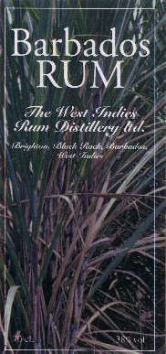
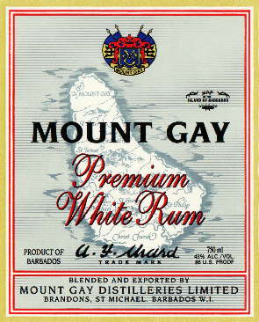
BARBADOS

Slide 22
CUBAN RUM
Characteristics of Cuban Rum:
  Distilled in Patent still.
  Light rums with fragrant and refreshing taste.
  Main Rums are Carta Blanca and Carta Oro.

Slide 23
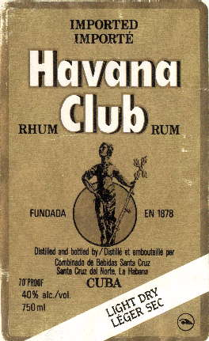
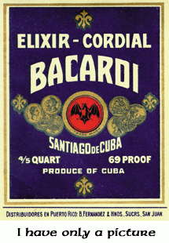
CUBAN RUM

Slide 24
GUADELOUPE RUM
Characteristics of Guadeloupe Rum:
  Major suppliers of French Rum.
  Full bodied rum.
  Distilled in Pot still.
  Main distilleries are Fort Ille, Tabanon, Bourdon, Bologne.

Slide 25
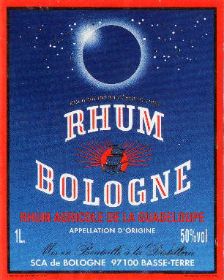
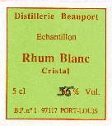
GUADELOUPE RUM

Slide 26
GUYANA RUM
Characteristics of Guyana Rum:
  Most famous Rum is Demerara.
  Very famous full bodied dark Rum.
  Distilled in Pot still.
  Main distilleries are Enmore, Diamond and versaille.

Slide 27
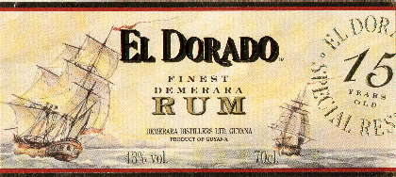
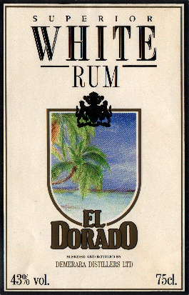
GUYANA RUM

Slide 28
HAITI RUM
Characteristics of Haitian Rum:
  Cane juice is used for making Rum.
  Double distilled in Pot still.
  1st distillation gives Clairins.
  2nd distillation makes clairins medium to full bodied rums.
  Main distilleries are Port-au-Prince, renowned Damien distillery of rhum Barbancourt.

Slide 29
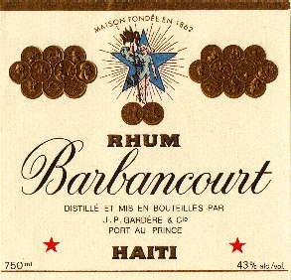
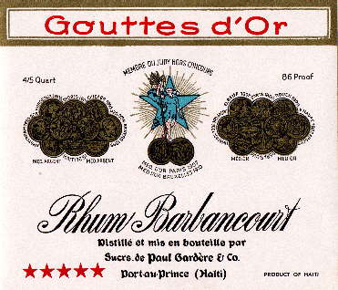
HAITI RUM

Slide 30
JAMAICAN RUM
Characteristics of Jamaican Rum:
  Described as Bordeaux of Caribbean.
  Full flavoured, dark and rich rums.
  In olden days they were called Wedderburn or Plummer.
  In recent times lighter rums are being produced..

Slide 31
JAMAICAN RUM
  In modern days made from molasses and distilled in 3 ways to produce 03 distinctive styles of rum:
    In patent still, after a short fermentation to give high alcohol. Results in light rum called common clean.
    In pot still, made from cane juice mixed with molasses. Results in medium bodied rums.
    After a long fermentation, distilled in pot still, made with molasses are heavy bodied rums.

Slide 32
JAMAICAN RUM
Is shipped to England for maturation and bottling.
Famous brands: Appleton, Lemon Hart, Punch,Captain Morgan

Slide 33
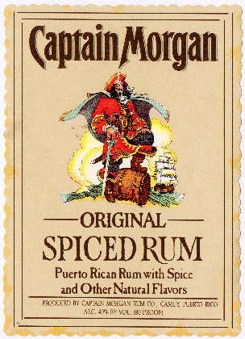
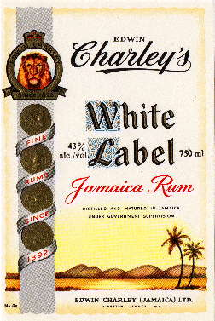
JAMAICAN RUM

Slide 34
PUERTO RICAN RUM
Characteristics of Puerto Rican Rum:
  Largest producers in whole of Caribbean.
  Leading producers of White rum.
  Manufactured from Molasses.
  Double distilled in patent still.
  Not matured in casks as it is intended to be clear.
  Famous brands are Bacardi, Ronrico, Ron viejo.

Slide 35
PUERTO RICAN RUM
Styles of Pureto Rican Rums:
White
  By law run off at 180-189 º U.S.
  Aged in wood for a minimum of 1 year.
Gold/Amber
  By law run off at 175 º U.S.
  Aged in wood for a minimum of 2-3 years.
Anejos
  By law run off at 175 º U.S.
  Aged in wood for a minimum of 4-6 year.

Slide 36
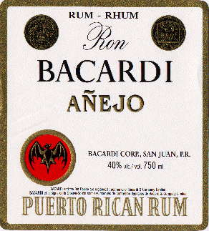
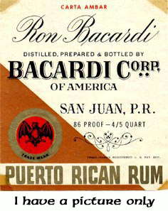
PUERTO RICAN RUM

Slide 37
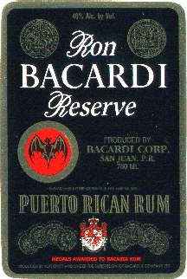
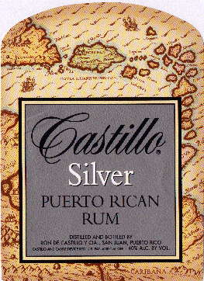
PUERTO RICAN RUM

Slide 38

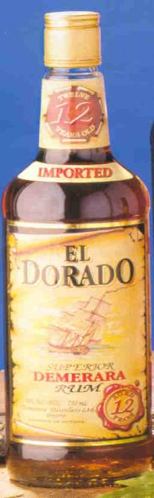
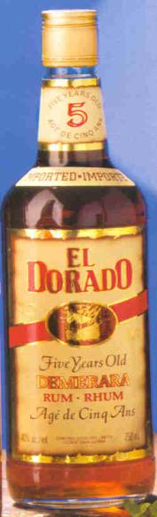
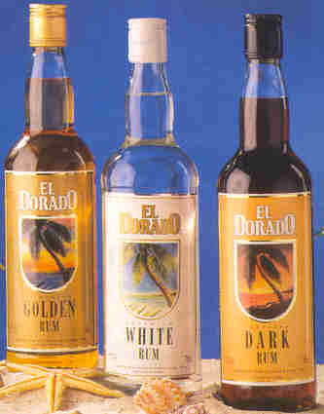
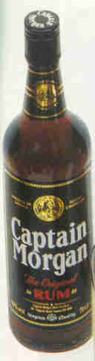
Tanduay - Phillipines
El Dorado
Captain Morgan

Slide 39
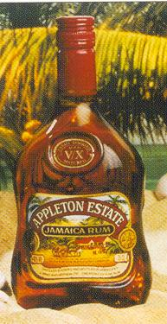
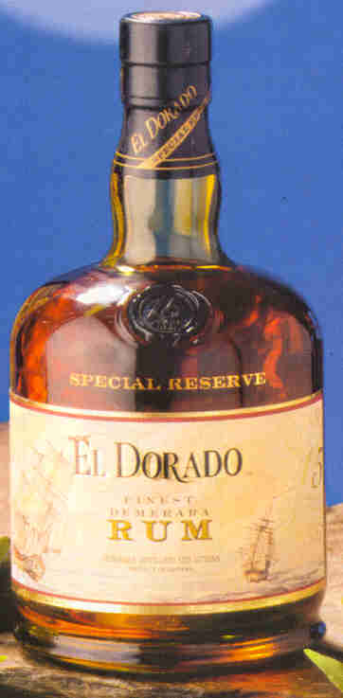
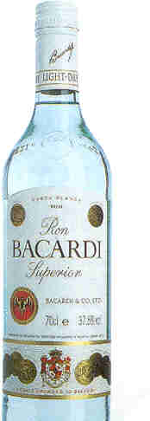
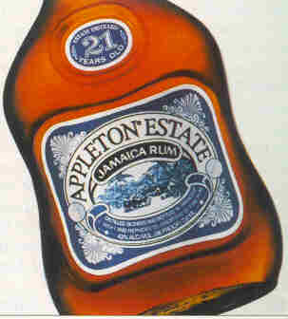
Appleton
Bacardi
El Dorado

Slide 40
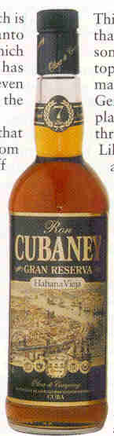
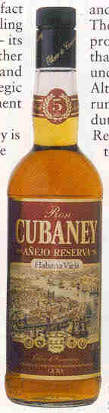
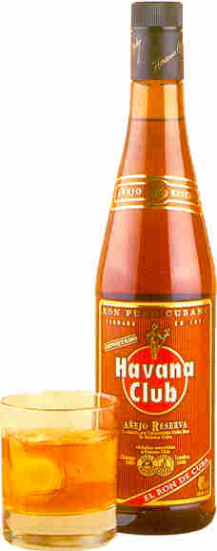
Cubaney
Havana Club

Slide 41
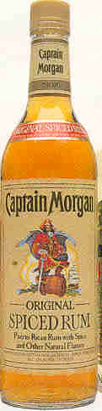
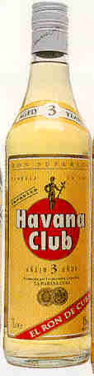
Captain Morgan
Havana Club

Slide 42
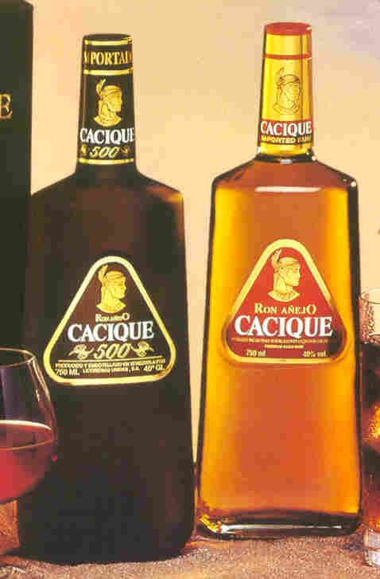
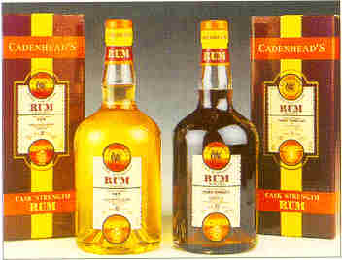
Some Other Brands
Cacique - Venezuela
Cadenhead - Scotland

Slide 43
RUM SERVED AT OBEROI HOTELS
Old Monk
Bacardi
Hawaiian
Koday’s XXX

